Slide 1
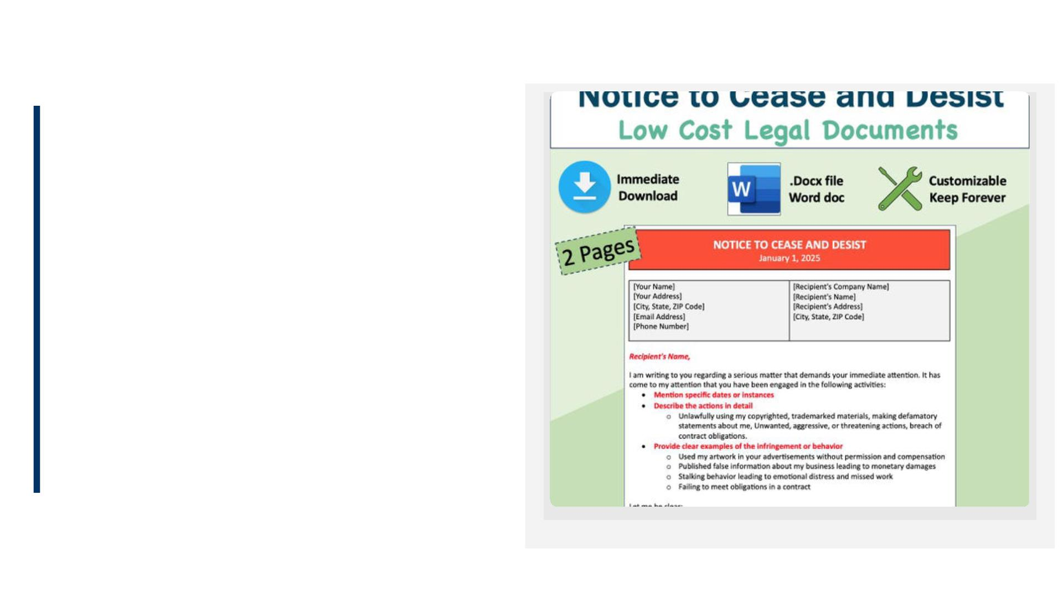
Bihar
Government
Servant
Amendment
Rules, 2026
A Comprehensive Overview of
the New Conduct Code
Ballkrishna Kumar
Associate Professor

Slide 2
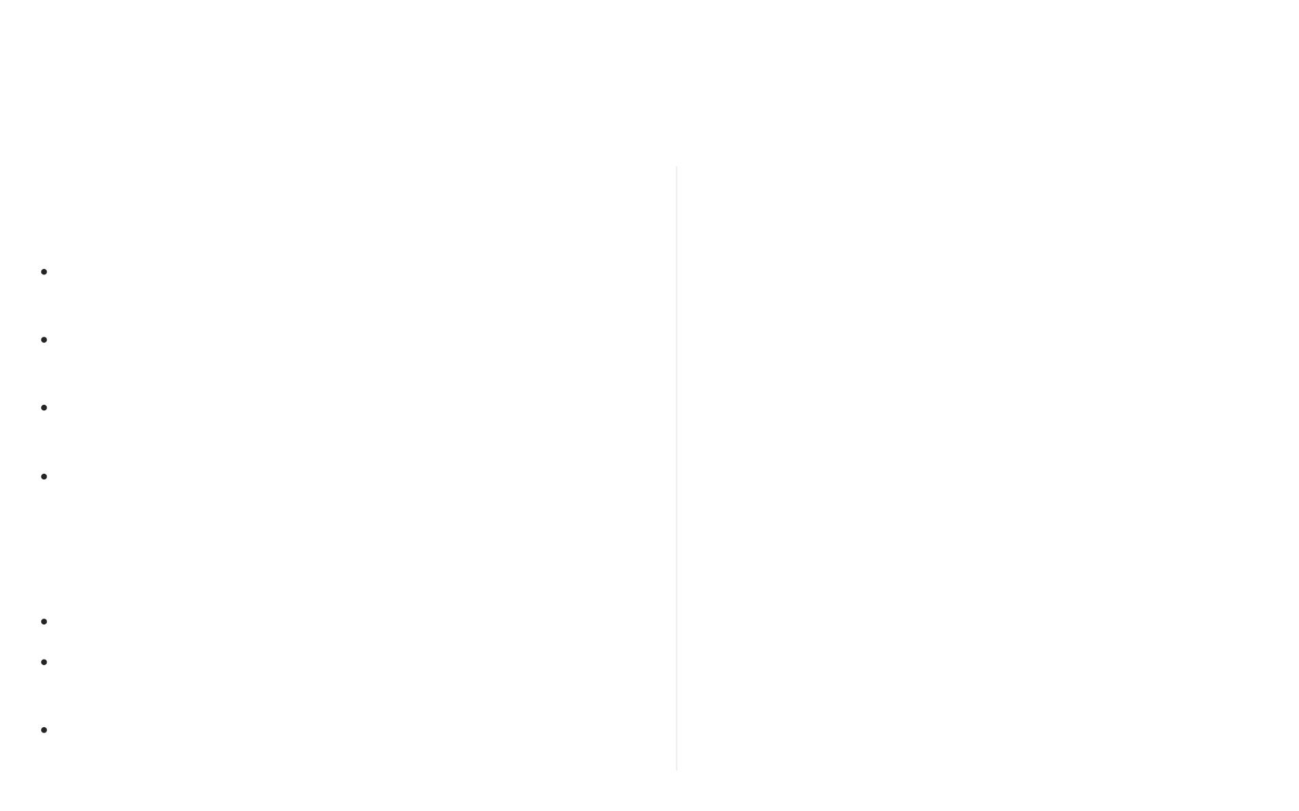
Bihar Government Servants Conduct (Amendment)
Rules, 2026
Background & Rationale for the 2026
Amendment
Amendment's Core Objectives

Mandatory Prior Permission for Social Media
Approved by the State Cabinet on January 29, 2026, under
Requires prior permission from the competent
authority to create or operate any social media
account.
CM Nitish Kumar.
Core Issue: Addresses the escalating misuse of digital
platforms by government servants.
Prohibition of Digital Misuse

Impacts Identiﬁed: Led to reputational damage, spread of
Deﬁnes and prohibits "objectionable content" and
activities that undermine government policies or
public image.
misinformation, and erosion of public trust.
Strategic Goal: Aims to establish clear boundaries
between personal expression and oﬃcial responsibility.
Maintenance of Oﬃcial Decorum & Neutrality
Ensures all digital activities uphold oﬃcial decorum
and neutrality, avoiding conﬂicts of interest.
⚖
✶
Key Dates & Applicability
Approval Date: January 29, 2026
Alignment with National Standards
Eﬀective Date: Immediate eﬀect upon notiﬁcation in the
Harmonizes Bihar's conduct code with national
standards for digital ethics among public servants.
Bihar Gazette.
Scope: Binds all government servants, including temporary,
contractual, or probationary roles.

Slide 3
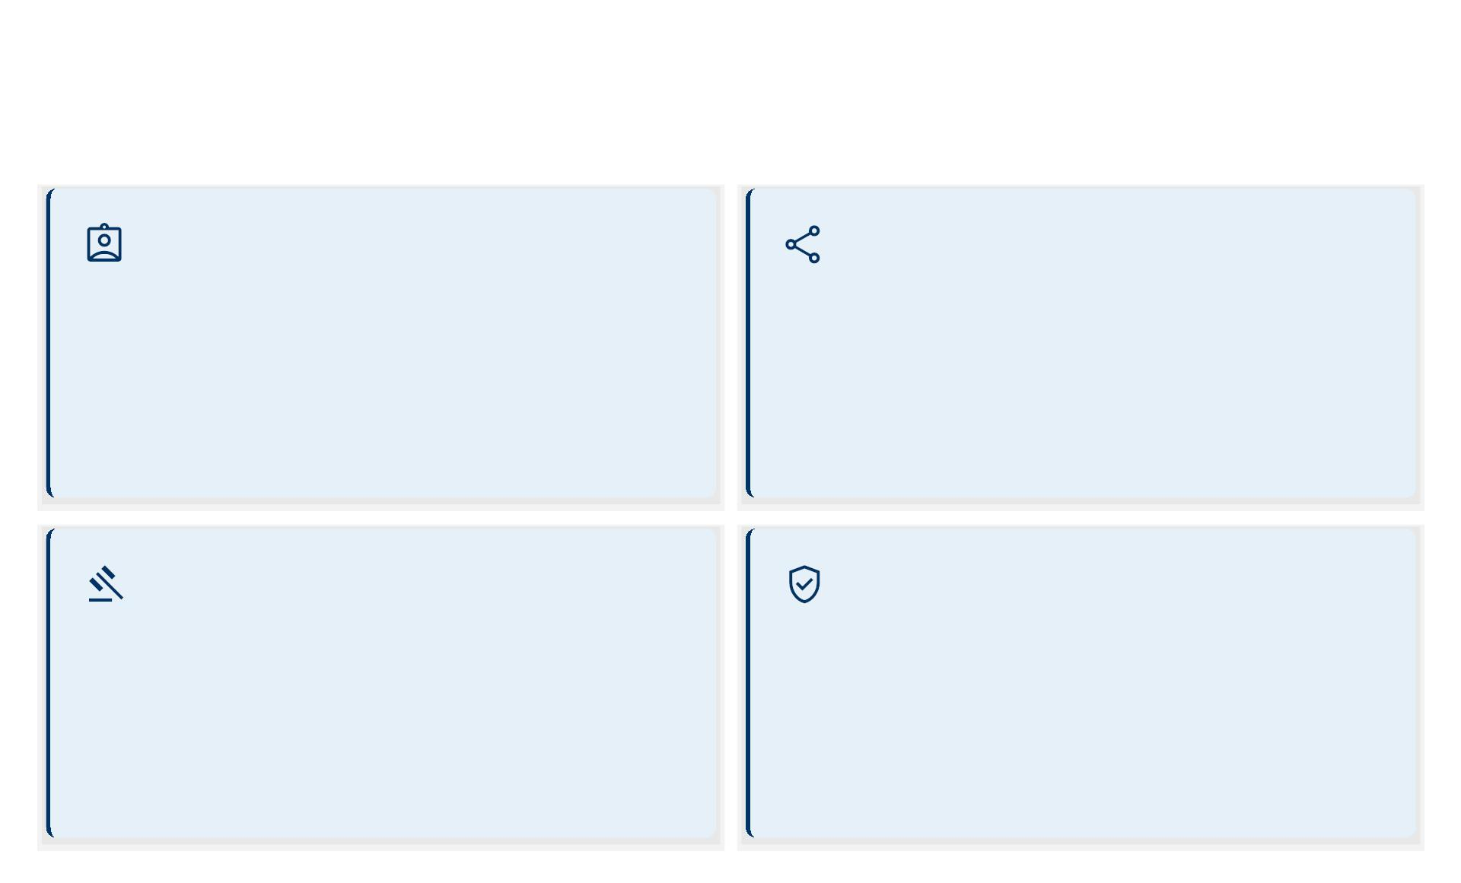
Key Provisions: Bihar Government Servants Conduct
(Amendment) Rules, 2026
Mandatory Prior Permission
Covered Social Media Platforms
Rule 3(1) requires government servants to obtain prior
written permission from the competent authority
before creating or operating social media accounts. Failure
to do so is a violation.
Rule 3(2) covers any public digital medium including
Facebook, WhatsApp (public groups), X, LinkedIn,
Instagram, YouTube, and TikTok.
Exemption: Private messaging is exempt unless used to
disseminate oﬃcial information.
Deﬁning 'Misuse' of Digital Platforms
Importance of Digital Responsibility
(a) Posting defamatory or inﬂammatory content.
(b) Sharing unveriﬁed or classiﬁed information.
(c) Endorsing political parties or religious agendas.
(d) Using oﬃcial insignia without authorization.
(e) Engaging in debates that undermine public conﬁdence.
Rule 4(2) states servants must uphold the integrity of
public service. Digital platforms are public spaces, and
online conduct must reﬂect neutrality, accountability,
and professionalism.

Slide 4
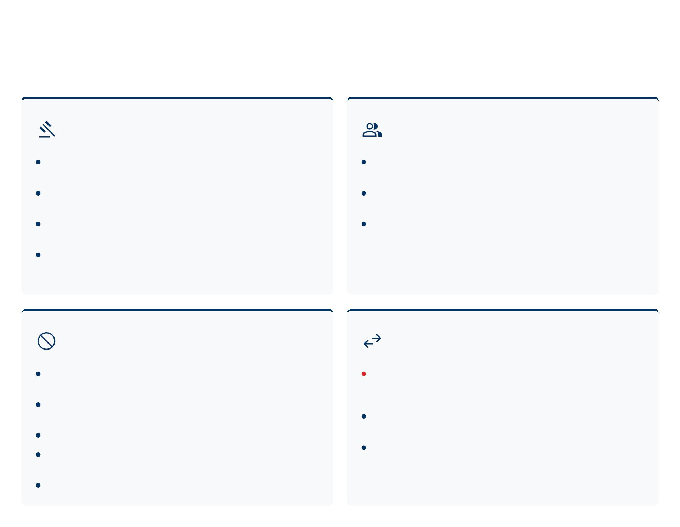
Rules for Social Media Usage (Bihar Government
Servants)
Standards for Usage (Rule 5(1) –
Updated 2026)
Maintaining Oﬃcial Decorum (Rule
5(3) – Reinforced 2026)
All proﬁles must clearly state 'This is a personal account and
Avoid any association with content that could be perceived as
does not represent the views of the Government of Bihar.'
reﬂecting an oﬃcial stance.
Oﬃcial titles, insignia, uniforms, or property must not be
Includes liking/sharing posts that undermine the
featured in proﬁles or posts.
government's image.
Posts must not contain language that is obscene, abusive,
This rule applies 24/7, regardless of work hours, emphasizing
discriminatory, objectionable, or provocative.
continuous vigilance.
Strictly prohibited from uploading conﬁdential documents or
any sensitive information.
Prohibited Content (Rule 5(2) –
Updated 2026)
Personal vs. Professional (Rule 5(4) –
Key 2026 Amendment)
No posting/sharing content that criticizes or ridicules
MANDATORY PRIOR PERMISSION: Prior written permission
from the competent authority is required before creating any
social media account.
government policies or colleagues.
No disseminating conﬁdential or sensitive documents,
reports, or applications.
Online persona must not conﬂict with oﬃcial duties or
No soliciting donations, favors, or political support.
undermine the government.
No promoting partisan political activity or inciting violence or
Explicit separation is crucial: No government emails for
personal accounts; no oﬃcial communication on personal
media.
hatred.
No impersonating any government entity or oﬃcial.

Slide 5
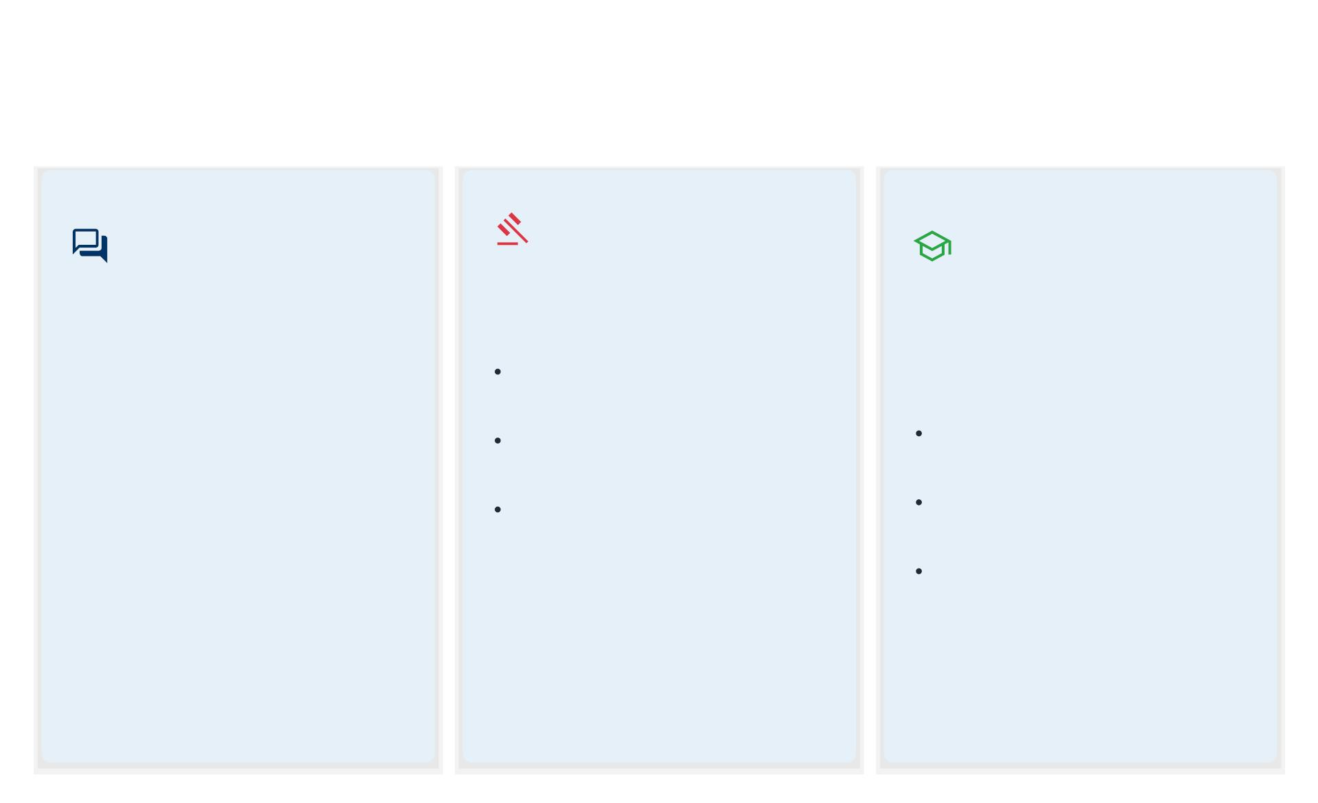
Key Provisions of the 2026 Social Media Amendment
(Rule 6)
1. Impact on
Freedom of
Expression
2. Potential
3. Training &
Awareness
Requirements
Disciplinary Actions
Rule 6(2) states that violations may
lead to:
Rule 6(1) acknowledges the
Rule 6(3) mandates that all
government servants undergo
training:
constitutional right to freedom of
speech under Article 19(1)(a) but
clariﬁes this right is subject to
reasonable restrictions under Article
19(2) when exercised by public
servants. The amendment does not
ban expression but regulates its
context and impact on public
service integrity.
First oﬀense: Written warning &
mandatory digital ethics training.
Second oﬀense: Suspension
Mandatory Orientation: Within
without pay for up to 30 days.
60 days of notiﬁcation.
Third oﬀense: Disciplinary
proceedings under Rule 10 of the
Bihar Government Servants
Conduct Rules, 1977, potentially
leading to removal.
Annual Refresher Training: To
be conducted yearly.
Module Development: The
Dept. of Personnel and Training
will create and distribute modules
with case studies.
Action may be based on complaints or
proactive monitoring by the Department
of Administrative Reforms.

Slide 6
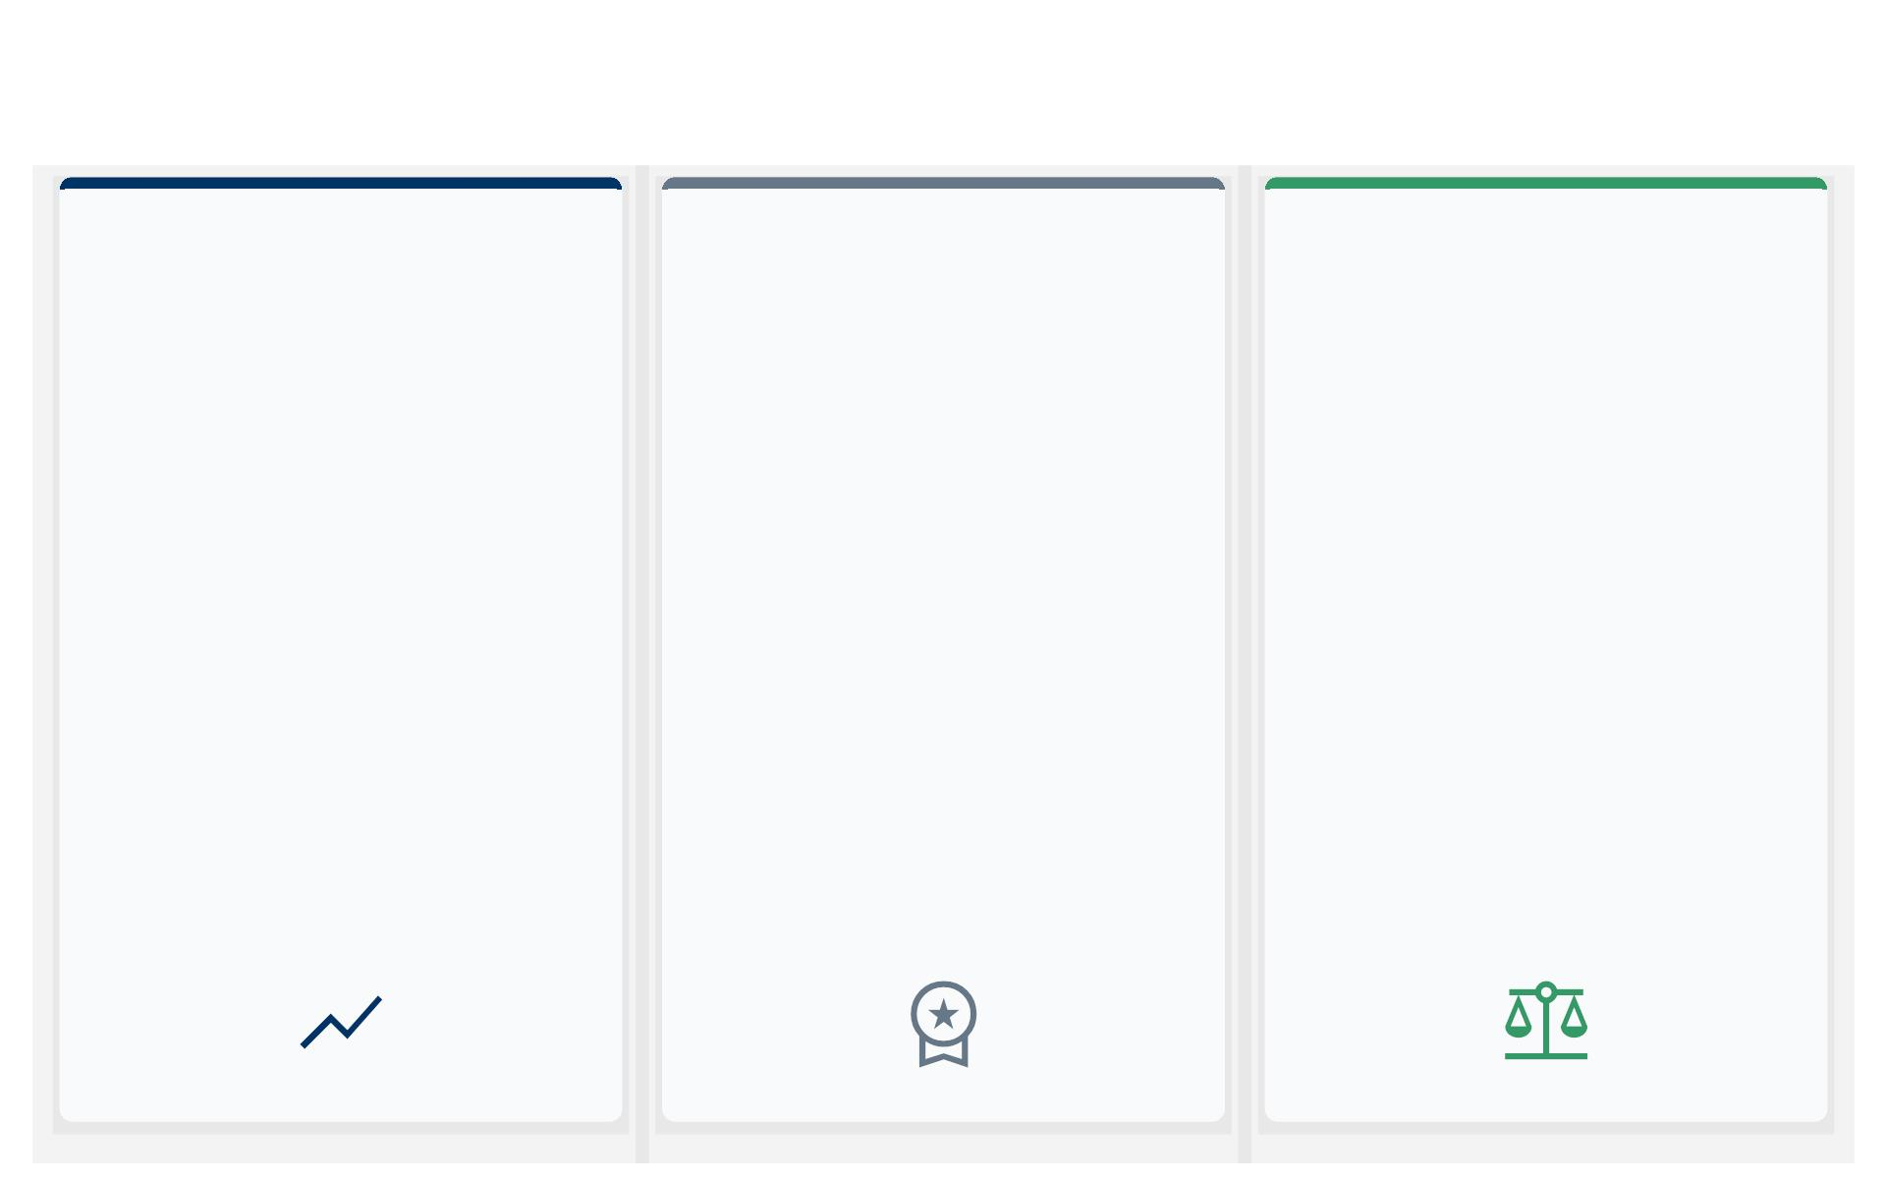
Broader Context and Comparison
Evolving Digital Conduct
Standards: National & Bihar's
2026 Amendment
Key Regulatory Approaches:
Lessons from Other States &
Bihar's Distinctive Model
Navigating Public Trust:
Balancing Freedoms with
Accountability
The Bihar Government Servants
Conduct (Amendment) Rules, 2026,
align with national frameworks like the
Central Civil Services (Conduct) Rules,
2021.
While Tamil Nadu uses a 'Digital Conduct
Charter' and Karnataka leverages AI
monitoring, Bihar's 2026 amendment is
distinguished by its explicit definition of
'misuse.'
Public servants are held to elevated
standards to prevent social media
weaponization against institutions while
respecting private expression.
These rules aim to preserve expression
A central tenet is the mandatory prior
permission from departmental
This includes prohibiting the
that does not compromise public trust.
dissemination of confidential documents,
sensitive information, or content
provocative to government policies.
Bihar's stringent guidelines reinforce the
government's commitment to discipline,
responsibility, and safeguarding the
integrity and public image of its
services.
authorities for employees to create or
operate any social media account.
Key prohibitions include sharing
confidential documents or content
deemed provocative towards
The state’s approach also emphasizes
mandatory training programs for all
employees, ensuring comprehensive
understanding and adherence.
government policies or sensitive matters.

Slide 7
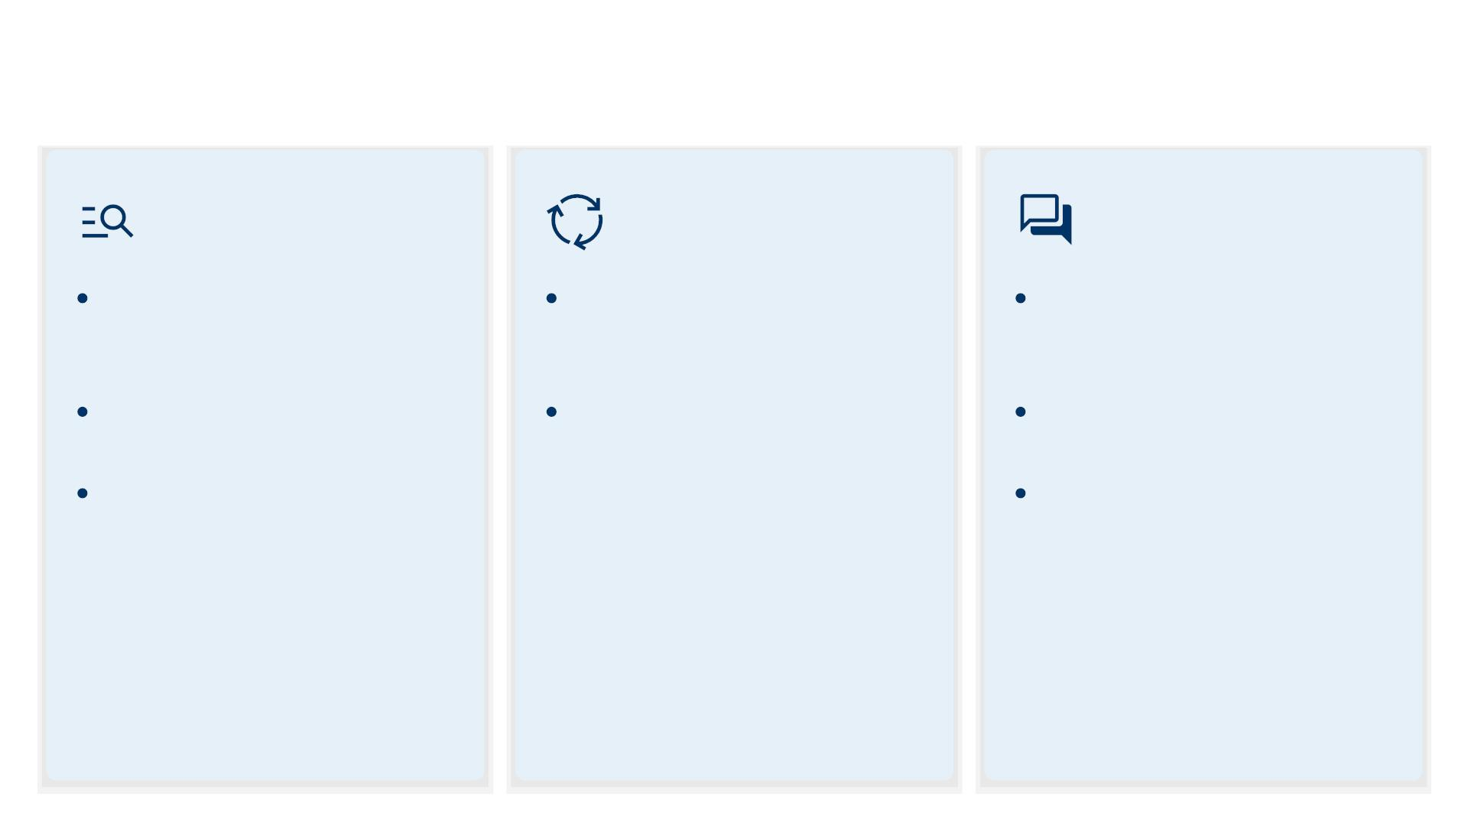
Rule 7: Oversight and Adaptation Mechanisms
Enforcement
Mechanisms
Adapting to Digital
Evolution
Feedback and
Review
A Digital Conduct Monitoring Cell is
established under the Department of
Administrative Reforms.
Rule 7(2) mandates a biennial review
to incorporate new platforms and
technologies.
Rule 7(3) institutes a public
consultation process every two
years.
The Cell receives public complaints
The State Cabinet can add or remove
platforms based on usage trends and
risk assessments.
A draft review report is published
and can initiate suo moto inquiries.
online for stakeholder feedback.
Investigations are by a three-member
committee: a senior officer, a legal
advisor, and a State Information
Commission representative.
The final review is presented to the
State Cabinet for approval.
Rule 7(1)
Rule 7(2)
Rule 7(3)

Slide 8
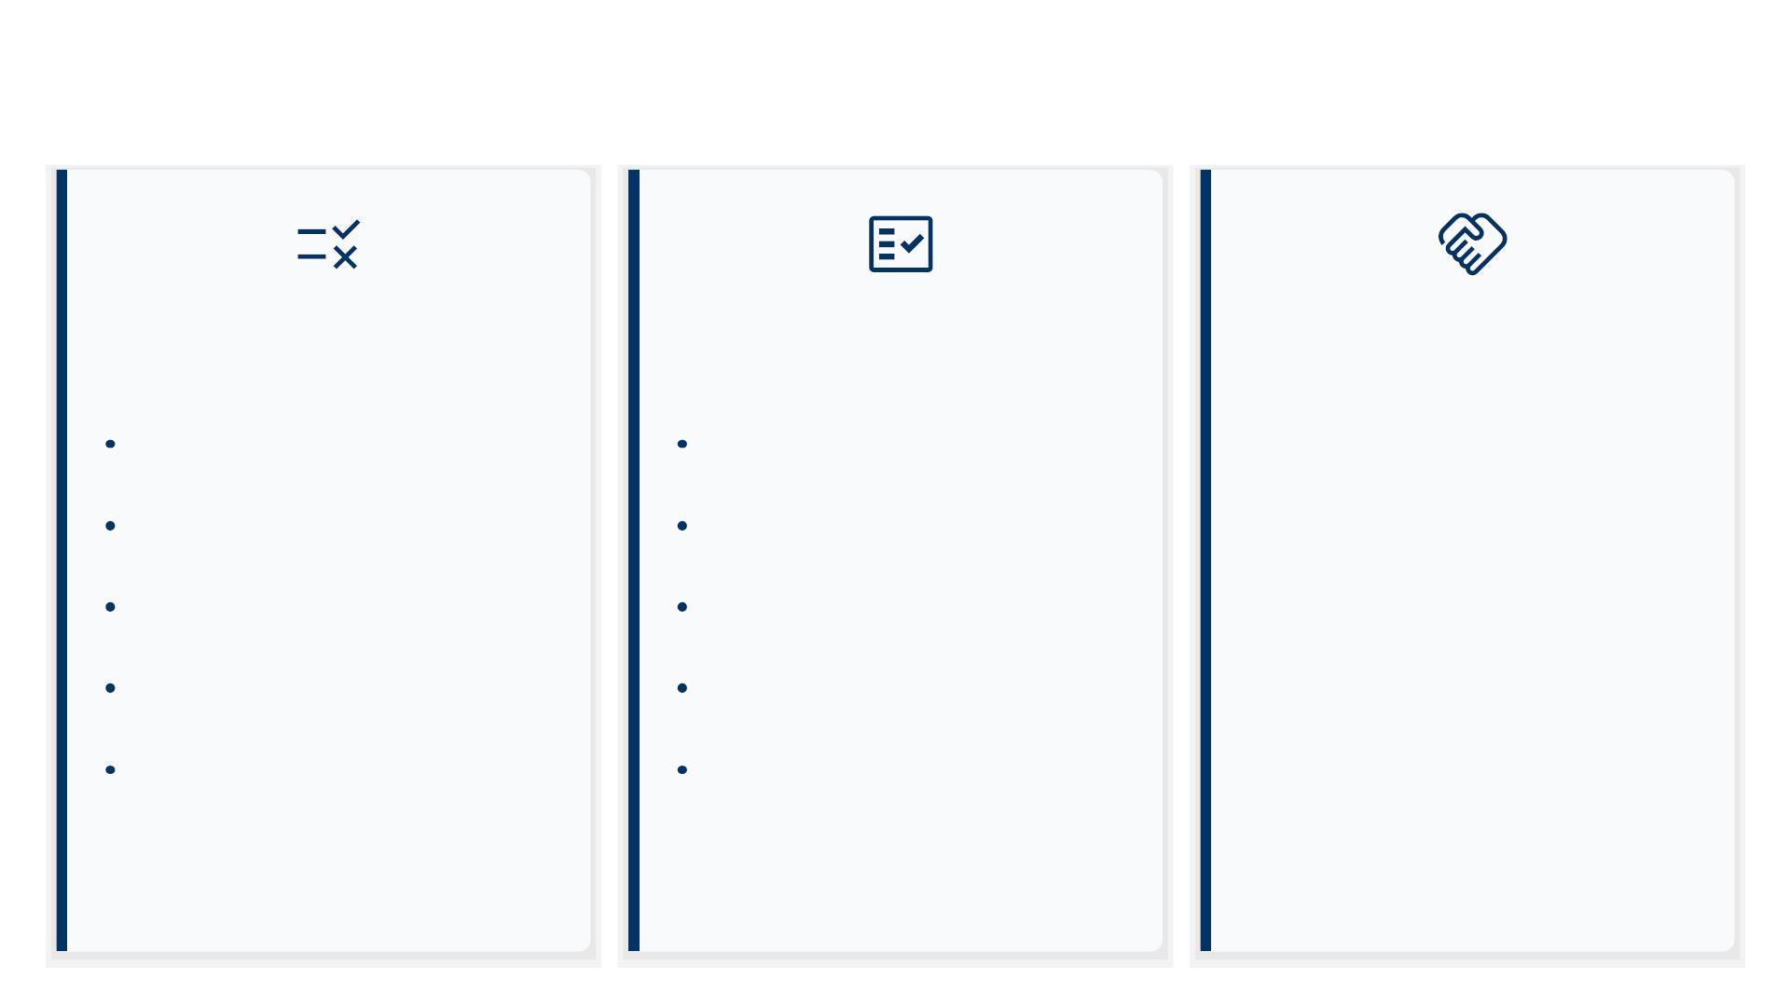
Summary and Key Takeaways
Recap of Major
Essential Compliance
Directives
Promoting Responsible
Amendments
Public Service
Mandatory prior permission for
Obtain written permission before
The 2026 amendment is not a
social media accounts.
creating any account.
restriction on speech but a framework
for responsible digital citizenship. It
reinforces that public service is a
privilege grounded in trust, and digital
conduct is a critical component of
maintaining that trust. Compliance
ensures the integrity of Bihar’s civil
service in the digital age.
Explicit deﬁnition of 'misuse'
Always label personal accounts as
(defamation, misinformation).
'non-oﬃcial'.
Comprehensive list of covered
Never use government insignia or
platforms.
titles online.
Clear separation of personal and
professional identity.
Avoid engagement with political or
controversial content.
Tiered disciplinary system with
Complete annual training on digital
mandatory training.
conduct.

Slide 9
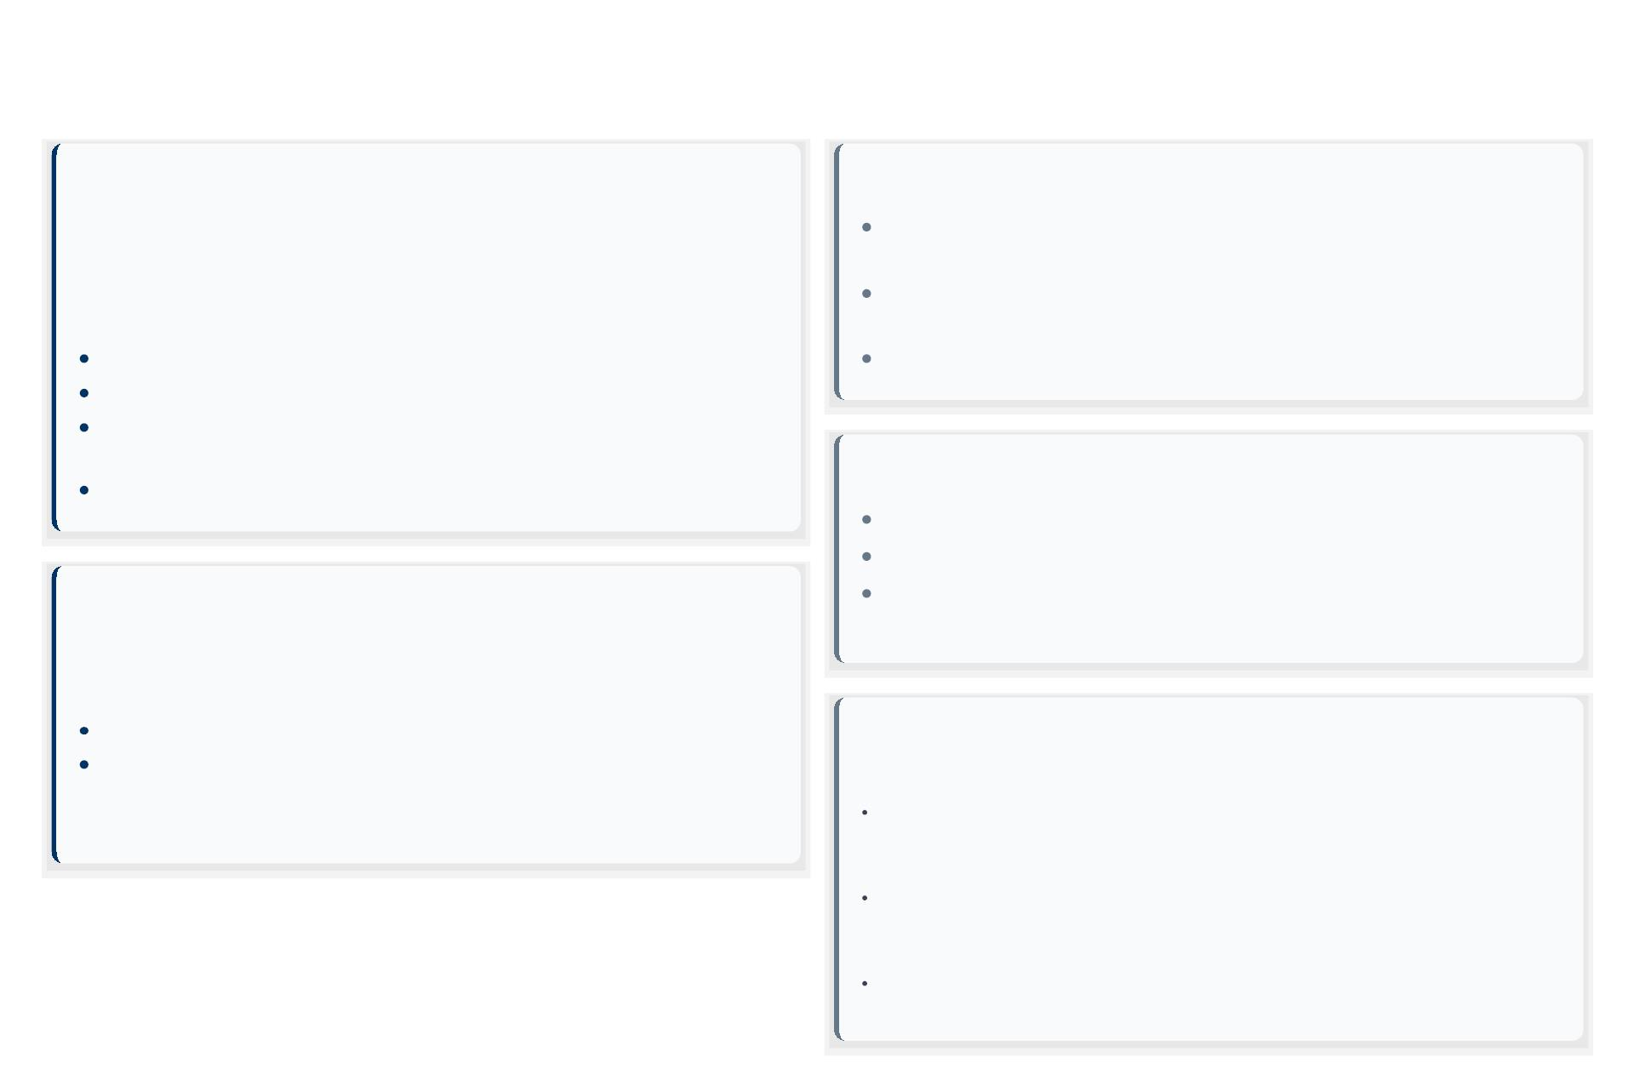
Rule References and Legal Citations
Primary Legal Instrument
Constitutional Pillars
Bihar Government Servants Conduct (Amendment)
Rules, 2026
Article 19(1)(a): Guarantees the Right to Freedom of Speech and
Expression.
Notiﬁcation No. 124/2026, dated Jan 29, 2026, published in the Bihar Gazette
(Extraordinary), Part II, Sec 3, Sub-sec (ii).
Article 19(2): Allows for Reasonable Restrictions in the interest of
public order.
Mandatory prior permission for social media accounts.
Strict prohibition on uploading conﬁdential documents.
Article 311: Provides Safeguards against dismissal or removal.
Bars posting objectionable content or undermining government
policies.
Supporting Regulatory Frameworks
Violations will invite punitive actions as per service rules.
Central Civil Services (Conduct) Rules, 2021.
Model Code of Conduct for Government Servants (2022).
Foundational Legislation
Digital Personal Data Protection Act, 2023 (for data handling
norms).
Bihar Government Servants Conduct Rules, 1977 (as
amended)
Rule 10: Disciplinary Proceedings
Rule 12: General Conduct
Enforcement & Compliance Mechanisms
Enforcement Authorities:
*The 2026 amendment reinforces these rules for contemporary digital
challenges.
Dept. of Administrative Reforms, State Information Commission, Dept. of
Personnel and Training, & Cybercrime Cells.
Disciplinary Actions & Appeals:
Processes as per Bihar Service Code; violations can lead to punitive action,
including dismissal.
Training & Awareness:
Regular training programs to ensure employees understand and comply with
updated rules.

